Slide 1
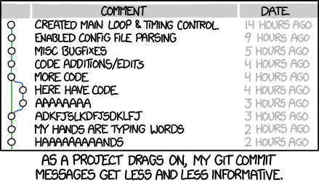
advanced git
Week 8
Google Slides Version
Source

Slide 2
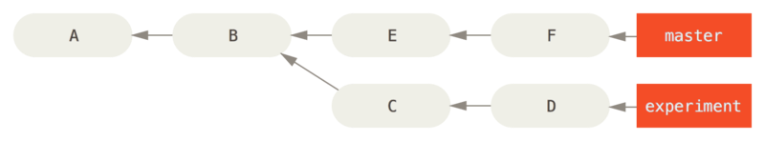
commits: ranges
git log [commit1]..[commit2]
Resolve a range of commits reachable from one commit but not the other. List the commits from commit1 (exclusive) to commit2 (inclusive).

Slide 3
commits: ranges
git log master..experiment
“all commits reachable from experiment that aren’t reachable from master”
→ D, C
git log experiment..master
→ F, E

Slide 4
commits: ranges
git log origin/master..HEAD
Any commits in your current branch that aren’t in the master branch on your remote origin. (In other words, lists the commits you still have to push to the master.)

Slide 5
commits: ranges
git log [commit1]...[commit2]
TRIPLE dots means all commits reachable by either branch but not both.
git log --left-right [commit1]...[commit2]
Shows which side of the range each commit belongs to.

Slide 6
commits: ranges
git log --left-right master...experiment
< F
< E
> D
> C

Slide 7
commit syntax: ^ and ~
^ refers to parent of a commit.
~ refers to first parent of a commit.
HEAD^ (parent) is equal to HEAD~ (first parent)
HEAD^2 (second parent) is not equal to HEAD~2(first parent of the first parent)
→ for example, merge commits have more than one parent

Slide 8
commit syntax
$ git log --pretty=format:'%h %s' --graph
* 734713b fixed refs handling, added gc auto, updated tests
* d921970 Merge commit 'phedders/rdocs'
|\
| * 35cfb2b Some rdoc changes
* | 1c002dd added some blame and merge stuff
|/
* 1c36188 ignore *.gem
* 9b29157 add open3_detach to gemspec file list
→ what does HEAD~ return in this case?

Slide 9
.git folder: index
Records which files are being tracked; the physical representation of the staging area. When you make a commit, files listed in the index folder are committed.

Slide 10
.git folders: objects
We talked about git having three types of objects: blobs, trees, and commits. Each object gets a unique hash; each of these is stored in this directory as compressed objects.
If you decompress these objects, you’ll get the objects corresponding information. So for example, decoding a commit object will give you it’s parent commits, it’s commit author, it’s commit message etc.
What you don’t get is any way to tell which object is a blob, tree, or commit without decompressing and checking; so you either decompress every object and check what it is, or rely on a different folder to tell you exactly why hash IDs are commit objects.

Slide 11
.git folders: refs
Contains files labeled by branch name. Each file contains the commit hash of the commit that branch points to. Refs will contain the commits pointed to by master, any side branches checked out, any remote branches.
So with the refs folder, we can get the id of the commit that a branch currently points at. Then, we can take that id and move to the objects folder, where we can search for the object corresponding to that id and decompress it to get information about that commit.

